Slide 1
SMART SHOES FOR VISUALLY IMPAIRED
CAPSTONE PROJECT 2
H-11

Slide 2
Introduction
This project presents a prototype model and a system concept to provide a smart electronic aid for blind people.
It aims to make the lives of the visually impaired much easier and smoother and help them feel included in the general crowd.
The shoes will alert them of any obstacles or people and allow others to either move or let the one wearing the shoes to halt.
These shoes will also inculcate and encourage social distancing as they will alert if someone is too close.

Slide 3
Objectives
Providing quality of life improvements to the visually impaired.
Encouraging social distancing.
Easing daily work of visually impaired person.
Making these people self-reliant in their work.
These technology may help this people to achieve somewhat economical freedom.
Making the visually impaired feel more included into the society.

Slide 4
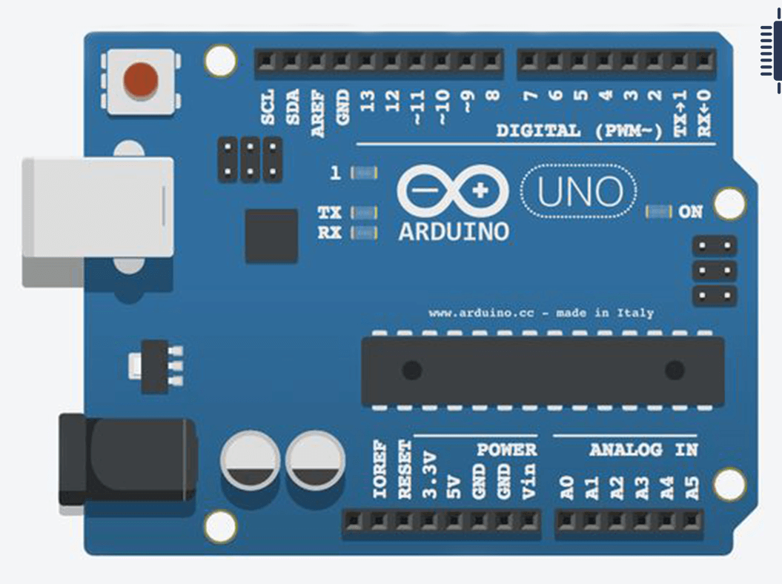
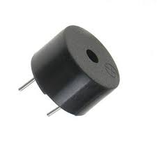
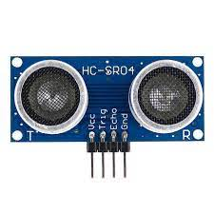
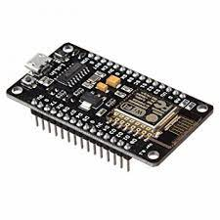
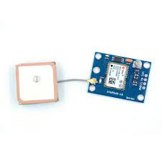
Components
Arduino Uno R3
Ultrasonic Distance Sensor
Piezo Buzzer
LED
Resistor
Neo 6m GPS module
Node MCU Esp8266

Slide 5


Tools and Technology
TinkerCad
Arduino IDE
TinkerCad will be used to simulate the circuit virtually for testing the connections .
Arduino IDE will be used to edit the codes for Node Mcu ESP 8266 and Arduino UNO R3.

Slide 6
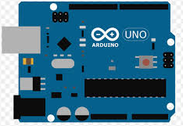
Methodology
We are using Arduino uno R3 , Ultrasonic Distance sensor , Led , buzzer , Bread board and resistor in our project .
Arduino uno R3 is a central part of the project . it will send inputs to the peripheral devices connected to it according to the inputs from the Ultrasonic Sensor .
Ultrasonic sensor is connected to the microcontroller . Ultrasonic sensor sends ultrasonic waves and according to that microcontroller will calculate the distance between the obstacle and the sensor .

Slide 7
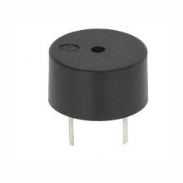
Methodology contd.
The Buzzer is connected to the microcontroller and the led is also connected to the microcontroller . all the components are connected to the microcontroller directly or by any other means.
When the distance between obstacle and the sensor is less than the desired , it will send input to the Arduino and then Arduino will Send inputs to the buzzer and buzzer will start to sound and also the led will glow .

Slide 8
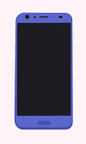
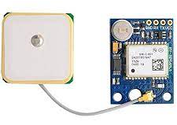
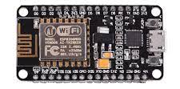
Methodology contd.
The relatives of the blind person will be able to track the blind person with the help of mobile .
The current location of the blind person will be sent with the help of the Neo-6m GPS module and NodeMCU ESP8266 Microcontroller. This Neo-6m sensor will be connected to the NodeMCU ESP8266 microcontroller.
This Microcontroller has a built-in wi-fi /Bluetooth with the help of which it can be easily connected to internet and the location can be sent on the mobile .This will help to the track the blind person

Slide 9
Literature Survey
Arduino IDE (Integrated Development Environment) is used to write the code and for uploading on the Arduino Uno. It has 20 digital input/output pins (of which 6 can be used as PWM outputs and 6 can be used as analog inputs), a 16 MHz resonator, a USB connection, a power jack, an in-circuit system programming (ICSP) header, and a reset button. It contains everything needed to support the microcontroller[1]
Two HCSR-04 ultrasonic sensor is used to locate the obstacle in the path of blind person. One sensor is mounted on the front end of shoe for detecting obstacle in forward path, while second sensor is mounted on the side of shoe for detecting sideward obstacle.[2]

Slide 10
Literature Survey contd.
A Piezo Buzzer is an electronic part commonly used to produce sound or a beep. They work by using a piezo crystal, a special material that changes shape when voltage is applied to it. If the crystal pushes against a diaphragm, like a tiny speaker cone, it can generate a pressure wave which the human ear picks up as sound[3]
To implement, the ultrasonic sensors, Arduino microcontroller are used. Based on signals, decision is made in Arduino to manage and give timely signals. The input string is from the ultrasonic sensors which generate high frequency sound waves and evaluate the echo which is received back by the sensor. Sensors calculate the time interval between sending the signal and receiving the echo to determine the distance to an object. Ultrasonic sensor can measure distances in centimeters and inches.[4]

Slide 11
Literature Survey contd.
This paper presents a Shoes which is integrated with ultrasonic sensors, vibration sensors and Bluetooth. These shoes can direct the user to his destination and can alert him about the impending obstacles on the path via the attached vibration sensors.[5]
This paper proposed the utilization of ultrasonic sensors. The ultrasonic sensors are the fundamental obstruction location gadget here. It conveys a reverberation message and from that ascertains the complete distance of an article from shoes. It offers loads of benefits over a visually impaired stick. Such sorts of shoes make hands free which can be can use them for holding any stuff or railing while at the same time climbing or diving the steps. The shoe likewise incorporates sensors to recognize deterrents like walkways, flights of stairs, and so forth Ultrasonic sensors figure the distance of the obstacles present in the manner[6]

Slide 12
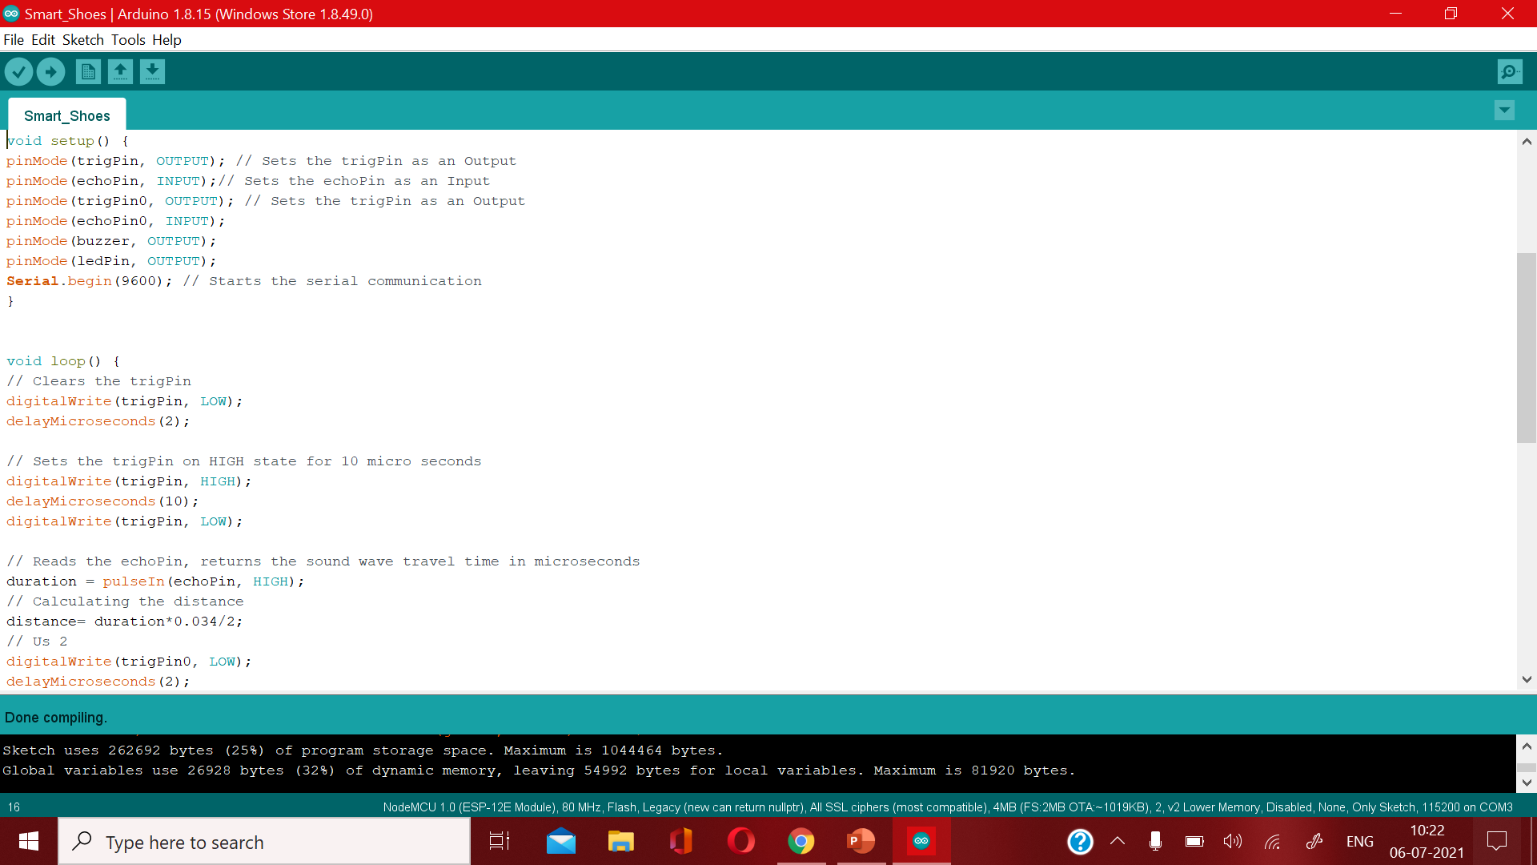
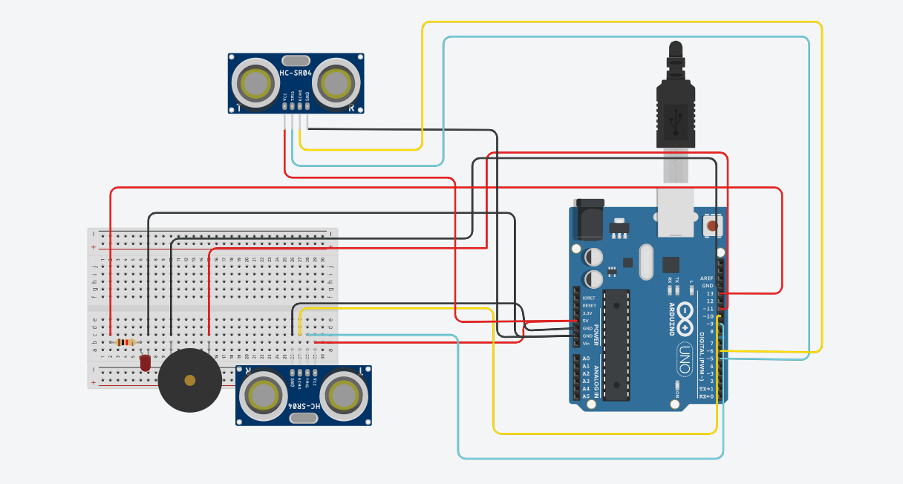
Result
In our project there is one good thing that it is depending on voice commands. Since we are dealing with visually impaired users, it also helps the other people nearby. and this gives project a strong advantage.
We can be extended to increase the range for further assistance along with integrated GPS feature, which will provide voice direction on detection of obstacles.

Slide 13
Conclusion
The project focuses on easing the work of the visually impaired. It can be used as an effective navigation tool for blind persons. This work can be extended to increase the range of obstacle detection and to send information for further assistance along with integrated GPS feature, which will provide voice directions on detection of obstacles in the path.
Due to these features, it is best equipment for the visually impaired people. Hence this project will solve the consequences faced by the visually impaired people.

Slide 14
References
Datasheets of components:
1]Arduino UNO:https://www.farnell.com/datasheets/1682209.pdf
2]UltraSonic Sensor: https://cdn.sparkfun.com/datasheets/Sensors/Proximity/HCSR04.pdf
3]Piezo Buzzer:https://www.mouser.com/datasheet/2/400/ef532_ps-13444.pdf\
4] Design Of Arduino Based Shoe For Blind With Wireless Charging Mohammad Hassan, .Atiqur Rahman, Shakeb Alam International Journal Of Electrical, Electronics And Data Communication, ISSN: 2320-2084
5] Smart Shoes – An Aid To Blind People Divya V Chandran , Aswathy N, Parvathy S Kumar Neelima Sunil , Nikhil Krishnan , Parvathy Krishnan International Journal of Advanced Research in Computer and Communication Engineering Vol. 9, Issue 12, December 2020 DOI10.17148/IJARCCE.2020.91211
6] Smart Shoes For Visually Impaired Using Iot Manali Tayade1, Serena Matla2, Raghuveer Deepala3, Yash Dekate4, Harsh Kadam5 International Research Journal of Engineering and Technology (IRJET) Volume: 08 Issue: 03 | Mar 2021

